Slide 1
Real-Time and Predictive CII Monitoring for RO-RO Ships
INTERNSHIP PROJECT PRESENTATION(Offline)
~SIDDHARTHA KOMMU
About me: My name is Siddhartha Kommu(SID-san). I am from Hyderabad, India, and I am a 4th-year Mechanical and Aerospace Engineering student at the Indian Institute of Technology Hyderabad (IITH).
I love swimming and I really enjoy eating Hyderabadi biriyani. I am really happy to share my project with you all today.

Slide 2
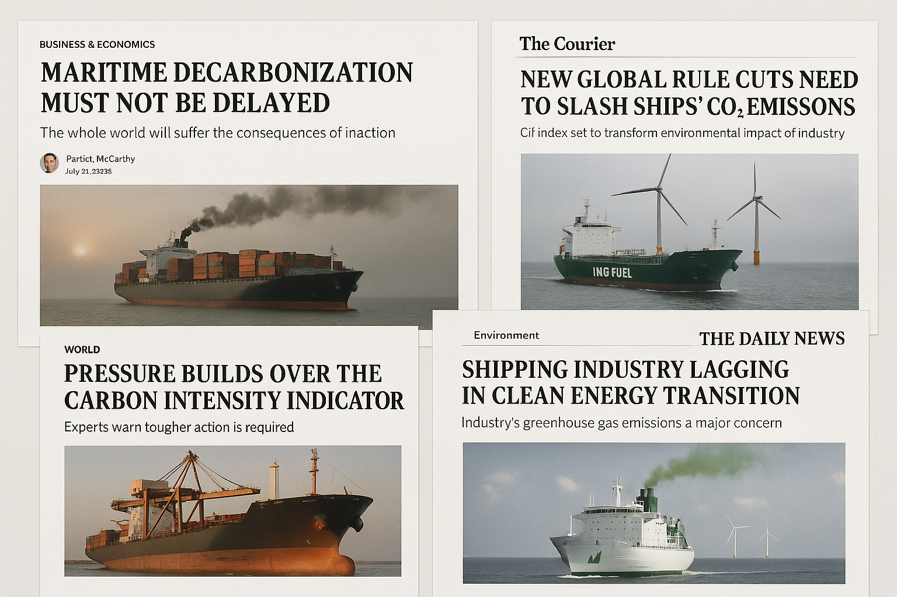
Maritime Decarbonization: The Burning Issue

Slide 3

Maritime Decarbonization: The Burning Issue
The world’s attention is turning to the urgent challenge of maritime decarbonization. As ships carry more than 80% of global trade, the shipping industry’s carbon footprint has become impossible to ignore. Every day, new headlines highlight the pressure on shipping companies to cut emissions and meet ambitious climate targets.
Why is it so important?
Shipping is responsible for nearly 3% of global CO₂ emissions—a number that is rising as global trade grows.
The International Maritime Organization (IMO) has set strict targets to cut emissions by at least 40% by 2030 and reach net zero by 2050.
Customers, investors, and governments are demanding cleaner shipping and greater transparency.

Slide 4
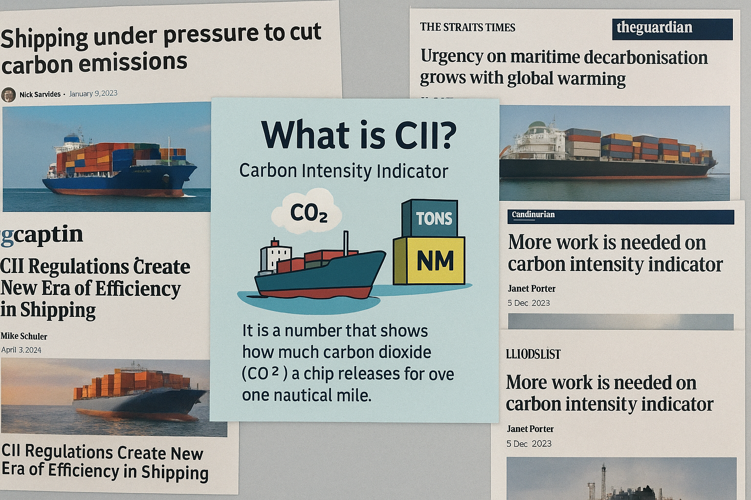
Tackling the Challenge: CII as a Solution

Slide 5

Tackling the Challenge: CII as a Solution
To help solve the problem of pollution from ships, the shipping industry uses something called the Carbon Intensity Indicator (CII).
Why is CII important?
It helps us see how clean the ship is.
Ships with a better (lower) CII use less fuel and pollute less.
The IMO (International Maritime Organization) now asks all ships to check and report their CII every year.
How does CII drive change?
Ships with better (lower) CII scores use less fuel and emit less CO₂, saving money and helping the environment.
By monitoring CII, companies can make smarter decisions about speed, route, maintenance, and upgrades.
CII ratings (from A to E) create healthy competition and motivate continuous improvement across the industry.

Slide 6
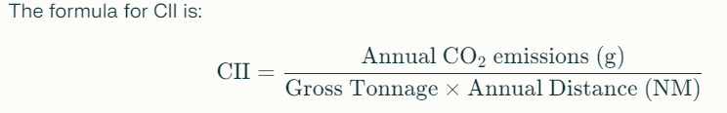
How to Calculate CII
Annual CO₂ emissions (g): How much CO₂ the ship produces in one year, calculated from the fuel it uses.
Gross Tonnage: The size or capacity of the ship.
Annual Distance (NM): How far the ship travels in nautical miles in one year.
How CII is Used
Ships get a rating from A (very good) to E (very bad) based on their CII.
If a ship gets a D or E rating for three years in a row, it must make a plan to get better.
Good CII scores mean less pollution, lower fuel costs, and following the rules.
In summary:
CII is a simple but powerful tool to help ships become cleaner, save money, and protect the environment. It is now a big part of how the shipping industry is working to fight climate change.

Slide 7
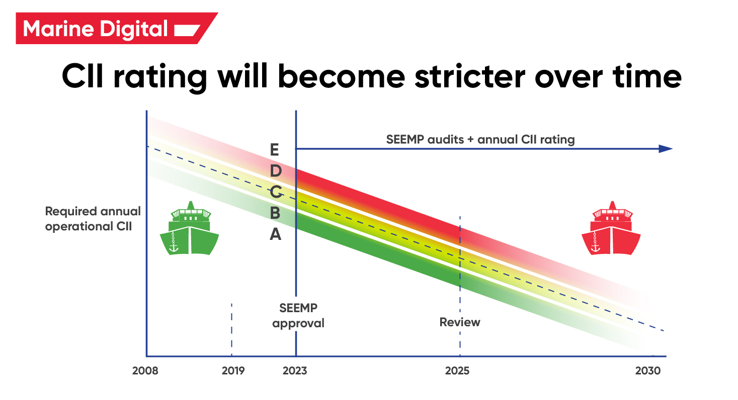

Slide 8

Reducing Ship Pollution with Data
What Was My Goal?
The Problem: Ships burn fuel and create a lot of pollution. But most crews don't know how clean or dirty their ship is day by day. They only get yearly reports, which is too late to make improvements in real time.
The Opportunity: If we could use the ship's daily operational data to predict CII quickly, We could give feedback right away, and that would help ships stay efficient.
My Project Aim: Build a machine learning (ML) model that takes in real ship data and predicts CII for each day.
Bonus: The model should also tell the crew how to improve their CII rating by suggesting small changes.

Slide 9
Reducing Ship Pollution with Data
My Goal:
Build a Machine Learning model that:
Takes in daily ship data (like distance travelled, speed, fuel, wind)
Calculates or predicts the CII for that day
Assigns a clear A–E rating
Gives simple suggestions to improve fuel efficiency and reduce emissions
Why This Matters:
Makes the crew more aware of how their actions affect pollution
Helps ships adjust faster and avoid long-term penalties
Saves fuel = saves money = saves the planet 🌍

Slide 10
How the ML Model Was Built
Flow Diagram For Annual CII Prediction Model (Model 1)
[Historical Operational Data (CSV/Manual Input)]
↓
[Data Preprocessing]
↓
[Feature Engineering & Selection]
↓
[Model Prediction (ML Model)]
↓
[Annual CII Calculation & Rating Assignment]
↓
[Optimization Suggestions Generation]
↓
[Output: Predicted CII, Rating, Suggestions]
↓
[User Interface: Manual Entry or File Upload]

Slide 11
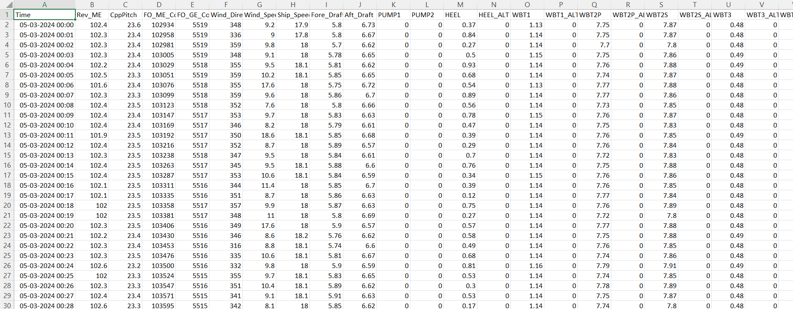
Sample Data – RO-RO Ship
Data Source: The data used in this project was collected from a RO-RO (Roll-on/Roll-off) ship, logged at one-minute intervals. Each row in the dataset represents one minute of the ship’s operation.
Key Columns in the Dataset:
Time: Timestamp when data was recorded
Rev_ME: Main engine RPM
CppPitch: Controllable Pitch Propeller (CPP) angle (in degrees)
FO_ME_Cons: Fuel oil consumed by the main engine (liters)
FO_GE_Cons: Fuel oil consumed by the generator engine (liters)
Wind_Direction: Wind direction (in degrees)
Wind_Speed: Wind speed (m/s)
Ship_Speed: Speed of the ship (knots)
Fore_Draft: Water depth at the bow (front) of the ship (m)
Aft_Draft: Water depth at the stern (rear) of the ship (m)

Slide 12
Data Cleaning & Preprocessing
Objective: Ensure the dataset is reliable, complete, and focused on actual sailing conditions for accurate modeling and analysis.
1. Date & Time Handling
Converted the "Time" column to datetime format.
2. Fuel Consumption Columns
Columns: FO_ME_Cons and FO_GE_Cons
Converted all entries to numeric.
Handled missing/non-numeric values using forward-filling (previous valid value is carried forward).
This ensures accurate fuel usage tracking over time.
3. Other Numeric Columns
Handled missing values for:
Ship_Speed, CppPitch, Wind_Speed, HEEL, Fore_Draft, Aft_Draft
Applied forward-filling to maintain continuity.
Converted all values to numeric format.
4. Removing Incomplete Records
Rows with missing values in critical columns (speed, drafts, fuel) were dropped.
5. Removing Idle/Port States
Removed rows where Ship_Speed ≤ 0.5 knots to focus only on active sailing periods.

Slide 13
Feature Engineering
Purpose: To derive new variables from raw data that better represent ship performance and fuel efficiency, enabling more accurate CII predictions.
1. Fuel Consumption per Minute
Calculated difference between consecutive rows of:
FO_ME_Cons (main engine)
FO_GE_Cons (generator)
Total fuel used per minute = sum of both.
2. Trim Calculation
Trim = Aft_Draft – Fore_Draft
Indicates ship’s front-back balance; affects resistance and efficiency.
3. Average Draft
Avg_Draft = (Fore_Draft + Aft_Draft) / 2
Represents how deep the ship sits in water.
4. CO₂ Emissions (g/min)
Fuel (liters) → mass (kg) using density (0.991 kg/L)
Multiplied by IMO emission factor (3.114 g CO₂/g fuel)
5. Distance Traveled (NM/min)
Speed (knots) converted to NM per minute: Speed / 60

Slide 14
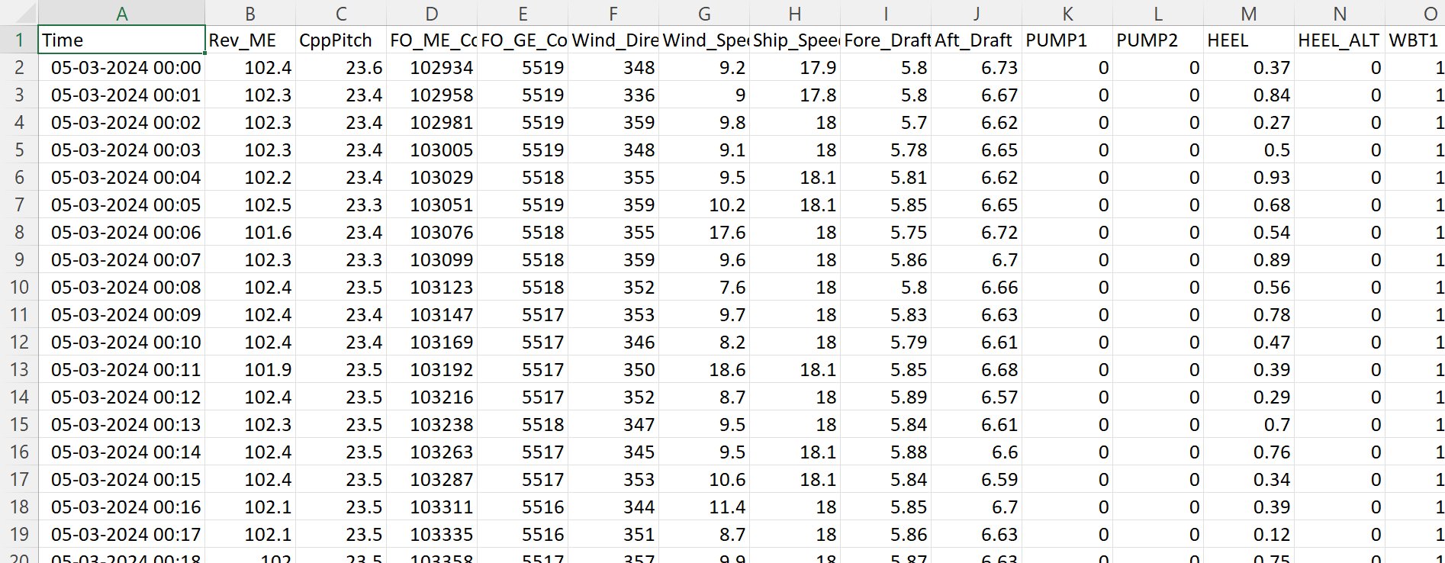
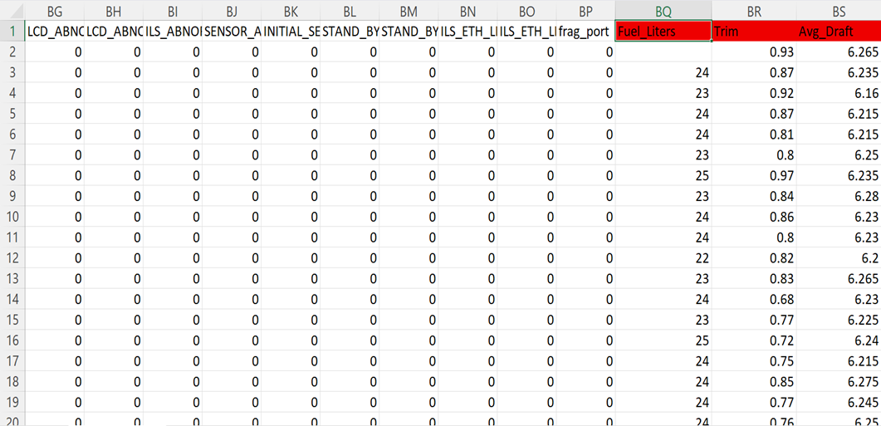
Feature Engineering
Cleaned RO-RO Data

Slide 15
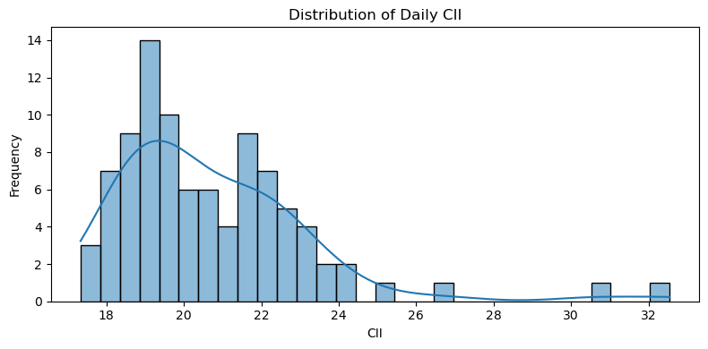
Annual CII Estimation
Goal: Predict each day’s projected annual CII using daily data and the IMO formula.
1. Annual Emissions & Distance
Annual CO₂ = Daily CO₂ × 365
Annual Distance = Daily NM × 365
2. CII Calculation
(Using IMO Formula)
3. Result
Each day becomes a training sample with input features and a predicted CII value.
4. Observations
CII values vary daily (18–30+)
Trends help identify days with high emissions

Slide 16
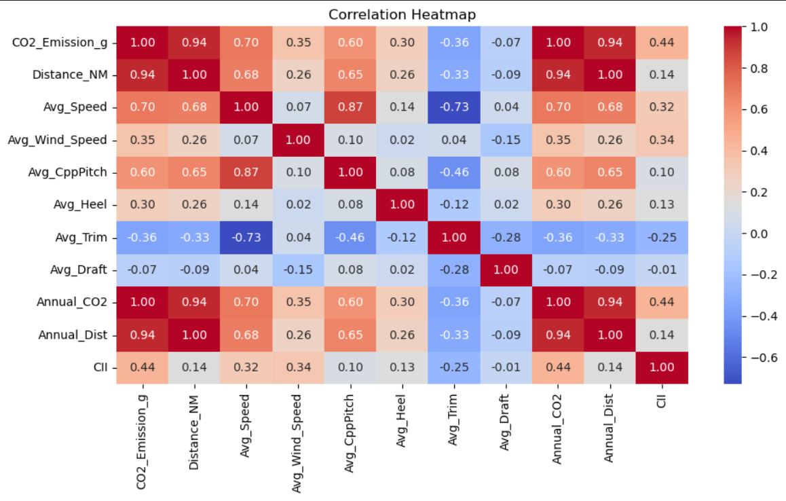
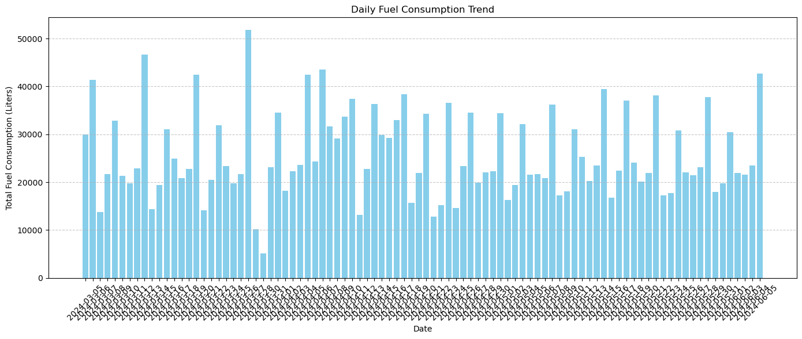
Exploratory Analysis
Daily Fuel Consumption Trend
Shows fuel usage variation over time.
Spikes may relate to longer voyages or rough conditions.
Correlation Heatmap
Strong correlation: Fuel ↔ CO₂ ↔ Distance

Slide 17
Feature Selection & Modeling Strategy
Objective: Predict daily CII values using operational data.
Target (y): Daily CII value
Selected Features (X):[CO₂ Emission (g), Distance (NM), Avg Speed (knots), Wind Speed (m/s), CPP Pitch (°),
Heel (°), Trim (m), Avg Draft (m)]
Train/Test Split (Time Series):
80% past data → training
20% recent data → testing
No shuffling to preserve time order
Feature Scaling:
Applied StandardScaler (mean = 0, std = 1)
Ensures fair contribution from all features
Dataset is now clean, scaled, and time-aware — ready for model training.

Slide 18
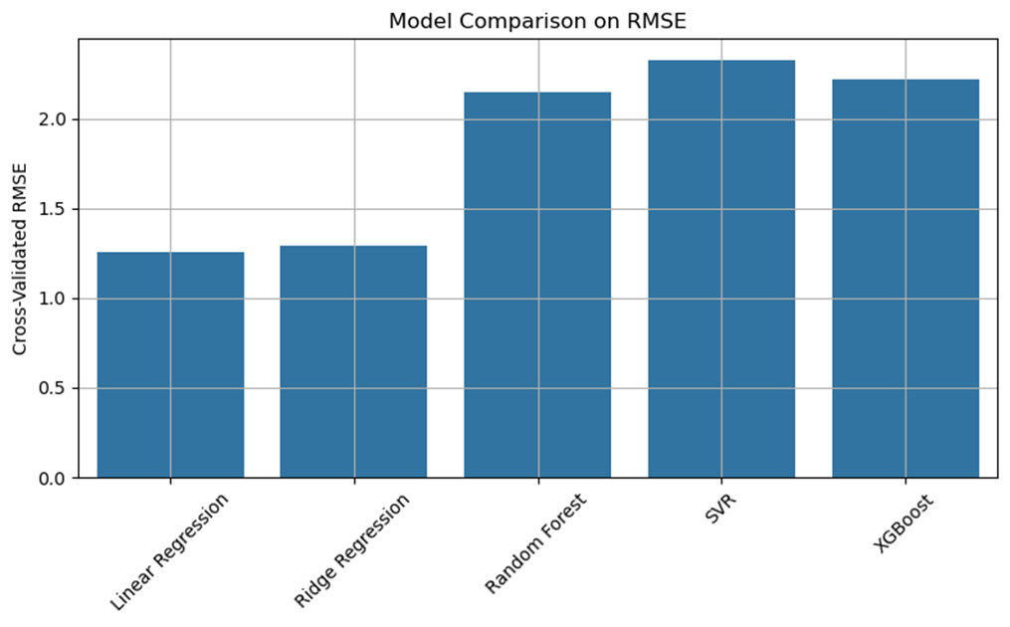
Model Comparison
Models Tested:
[Linear Regression, Ridge Regression, Random Forest, SVR, XGBoost]
Evaluation Method:
5-Fold Cross-Validation on training set
Metric: Root Mean Squared Error (RMSE)
Goal: Identify the most accurate, stable model
Initial RMSE Results:
Linear Regression: 1.25
Ridge Regression: 1.29
Random Forest: 2.14
SVR: 2.33XGBoost: 2.22

Slide 19
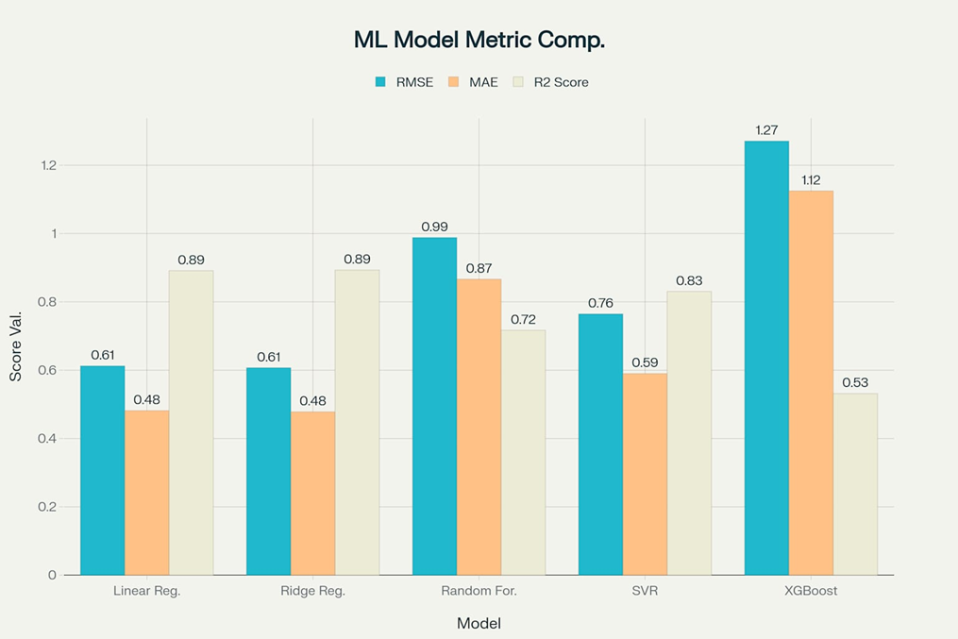
Hyperparameter Tuning
Why Tuning is Important: Default settings rarely yield optimal results. Tuning improves accuracy, generalization & stability.
Models Tuned:
[Linear, Ridge, Random Forest, SVR, XGBoost]
Used Grid Search with 5-fold cross-validation
Evaluated using RMSE, MAE, R²
Results After Tuning:
Model | RMSE | MAE | R²
Linear Regression | 0.6123 | 0.4815 | 0.8913
Ridge Regression | 0.6073 | 0.4779 | 0.8930
Random Forest | 0.9883 | 0.8665 | 0.7167
SVR | 0.7647 | 0.5900 | 0.8304
XGBoost | 1.2708 | 1.1250 | 0.5316

Slide 20
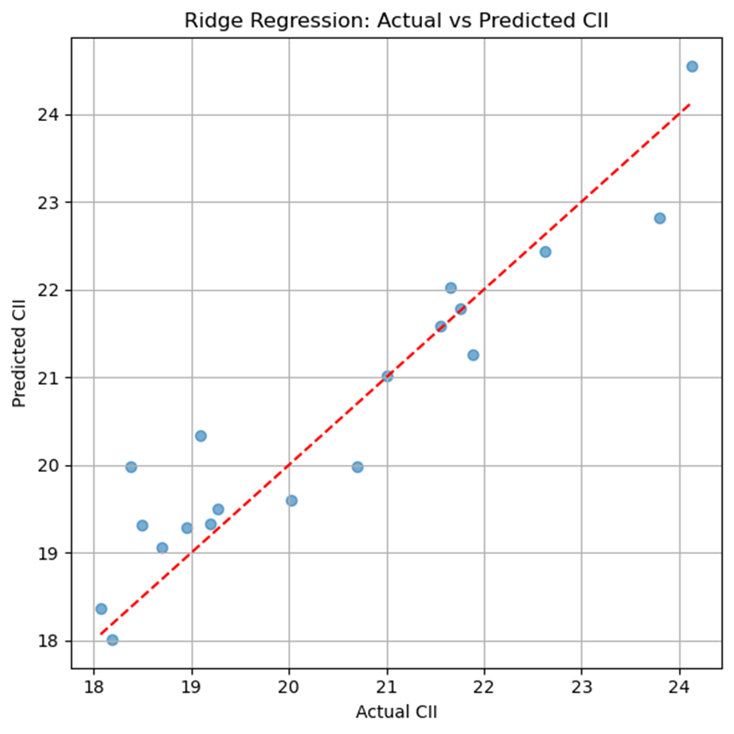
Final Model – Ridge Regression
Model Chosen: Ridge Regression (after hyperparameter tuning)
Performance Metrics:
RMSE: 0.6350 | MAE: 0.4730 | R² Score: 0.8830
Why Ridge? ✔ Best balance of accuracy & stability ✔ Handles correlated features well ✔ Simple, fast, interpretable
Adjusted CII Rating Bands (scaled for this dataset):
A: ≤ 15.75 | B: 15.75–18.20 | C: 18.20–20.45 | D: 20.45–22.70
E: > 22.70
Daily Suggestions (Examples):
Reduce trim to improve efficiency
Balance ballast to reduce heel
Maintain optimal cruising speed
Avoid sailing during high winds (Shown alongside predicted CII & Rating)

Slide 21
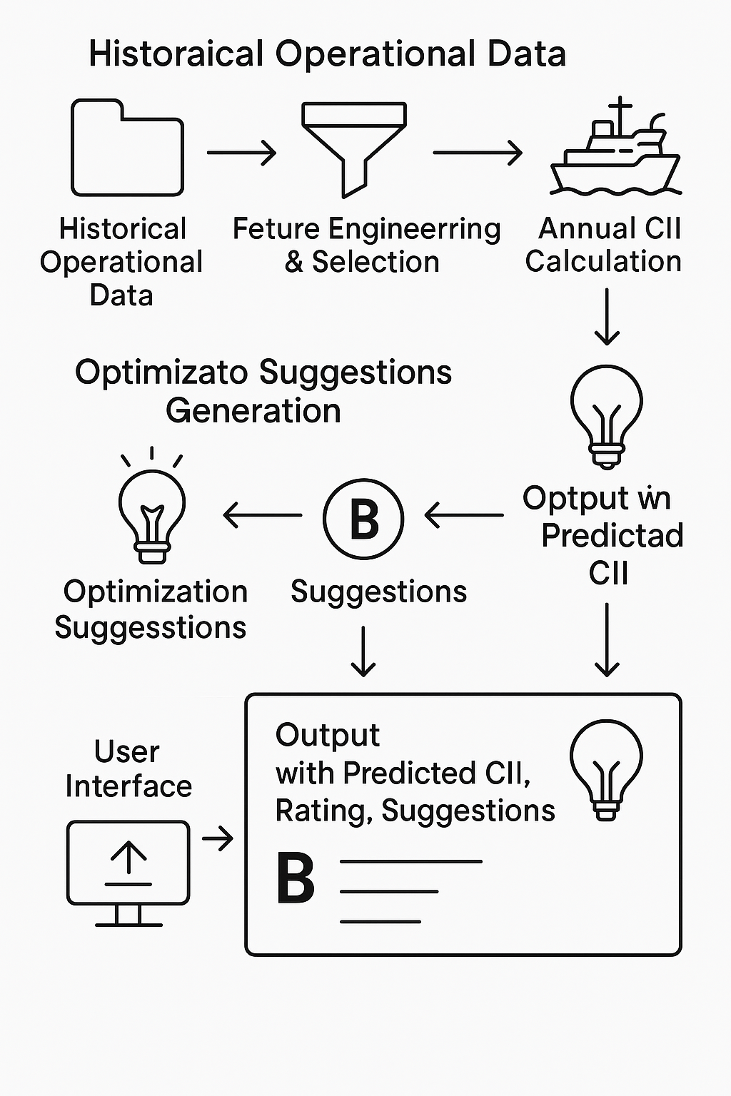
Summary of ML Model 1
What We Built: 🔹 Daily CII prediction tool using real ship data 🔹 Model trained on 4-month dataset (daily-level) 🔹 Simple inputs → Actionable insights
What Does the Model Do?
Every day, the model:
Predicts the ship’s CII
Assigns a rating from A (excellent) to E (poor)
Provides helpful suggestions to improve CII E.g., “Increase speed slightly”, “Reduce trim”, etc.
Why It Matters:
Empowers crews with data-backed decisions
Supports IMO compliance
Reduces emissions + fuel costs
✅ Practical, user-friendly, and ready for real-world deployment

Slide 22
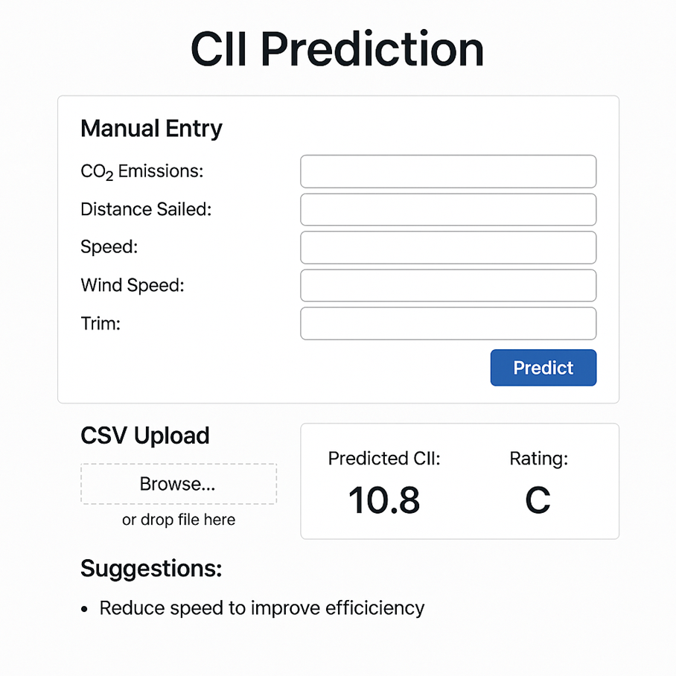
Easy to Use for the Crew
Crew can manually enter values using a simple interface
Or upload a CSV file with daily averages
The model gives instant results: prediction, rating, and advice
This makes it practical and useful even for people with no technical background.
It's Working. Time to Show You!
The model has been trained, tested, and runs perfectly
Let me now show you how it works live

